Slide 1

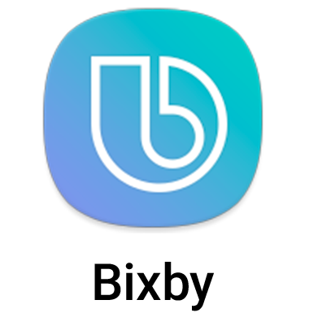

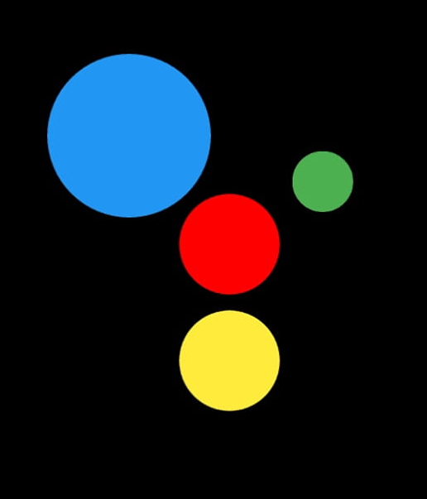
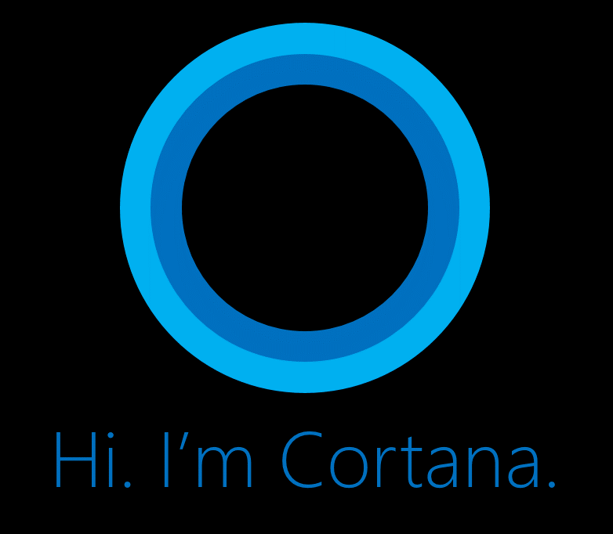
Virtual Assistant Using Python
Shreyash S. Tare – 19UET048
Pratik P. Kurdekar – 19UEL045
Mohit A. Mokashi – 19UEL051

Slide 2
Index
What is Virtual Assistant ?
What it does ?
How it works ?
Data flow Diagram
Virtual Library Requirements
Advantages
Disadvantages
Future plans and scope
Conclusion

Slide 3
What is Virtual Assistant ?
It is a Virtual Assistant technology based on Artificial Intelligence.
This software program use device's microphone to receive voice requests and processing on it and send response via Speaker.
It is combination of different technologies like Voice Recognition, Language Processing, Voice Analysis.
This software program is developed using pythonlanguage and his modules.

Slide 4
What it does ?
Greeting you as per real time.
Finds the information online through Wikipedia.
Play content from Youtube by using Chrome.
Gives us latest news.
Tells us interesting Facts.
Plays music from Spotify by using Chrome.
Tells Jokes.
Weather forcasting.
Tells us current day, date and time.

Slide 5
How it works ?
User ask the Assistant to perform the task.
The natural language audio signal is converted into digital data that can be analyzed by the software.
Compared with a database of the software using an innovative algorithm to find a suitable answer.
For this reason, it must have a reliable Internet connection.

Slide 6
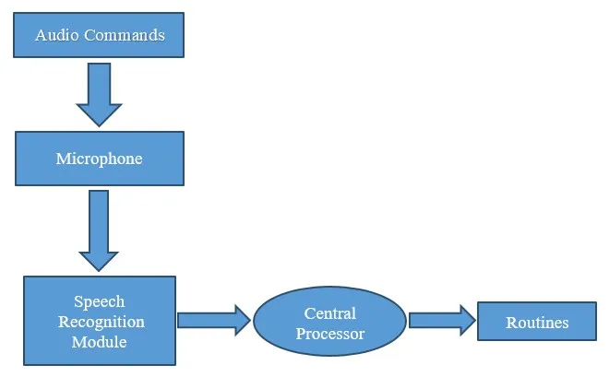
Data-flow diagram

Slide 7
Virtual Library Requirements
pyttsx3 :- Python text to speech version 3.
speech_recognization.
pyjokes
randfacts
datetime
json data for weather and news.

Slide 8
Advantages
Easily configured to perform many of regular tasks by simply giving voice commands.
Voice based search that is a boon for many like senior citizens who are not comfortable using the keypad/keyboard.
Able to write the text through both keyboard and voice input.
Different notepad commands such as open save clear etc.
Requires less consumption of time in writing text.
Lower operational costs.
Open different windows soft wares, based on voice input

Slide 9
Dis-Advantages
A user has to speak much louder and slower than their normal speed and volume
Not good in noisy place.
Low accuracy.

Slide 10
Future Plans & Scope
Future plans :-
Password protection.
Graphical user interface.
Face Recognition.
Try to add more functionality.
Scope :-
Navigation.
Gaming.
Physically disable people, Senior Citizens.

Slide 11
Conclusion
In this project we discuss about how what is this software and how it performed.
With respect to less cost and less disadvantages we will says that, this system can be have good future.
We also saw the how artificial intelligence is the future of the upcoming modern world.

